Slide 1
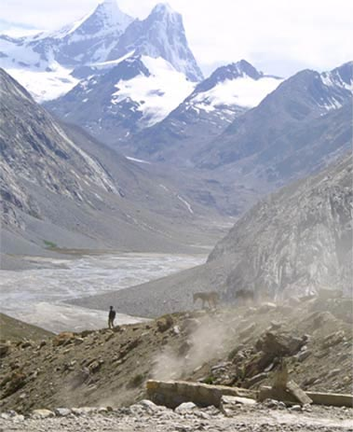
Fellowship of the Heart
Getting Started — the Four Connects, walked around the table on alternating evenings
Evening Series 2026–27 · at the Tittle home · v1.5E DRAFT
All Scripture: ESV · The Companion lesson plans carry the full scripts — these slides carry the room
1
Notes:
DECK TITLE · pre-session · DIVIDER
On screen as the room assembles on night one. All Scripture ESV; the plans carry the scripts; these slides carry the room — and these notes carry you.

Slide 2

SESSION 12
The Return
Coming home after the break — reading honestly what held, welcoming every walker back, and beginning again
Quarter 3: Mission & Rhythm
152
Notes:
S12 · pre-session · DIVIDER
On screen through dinner and as the circle forms. Greet at the door — the slide holds the room.

Slide 3
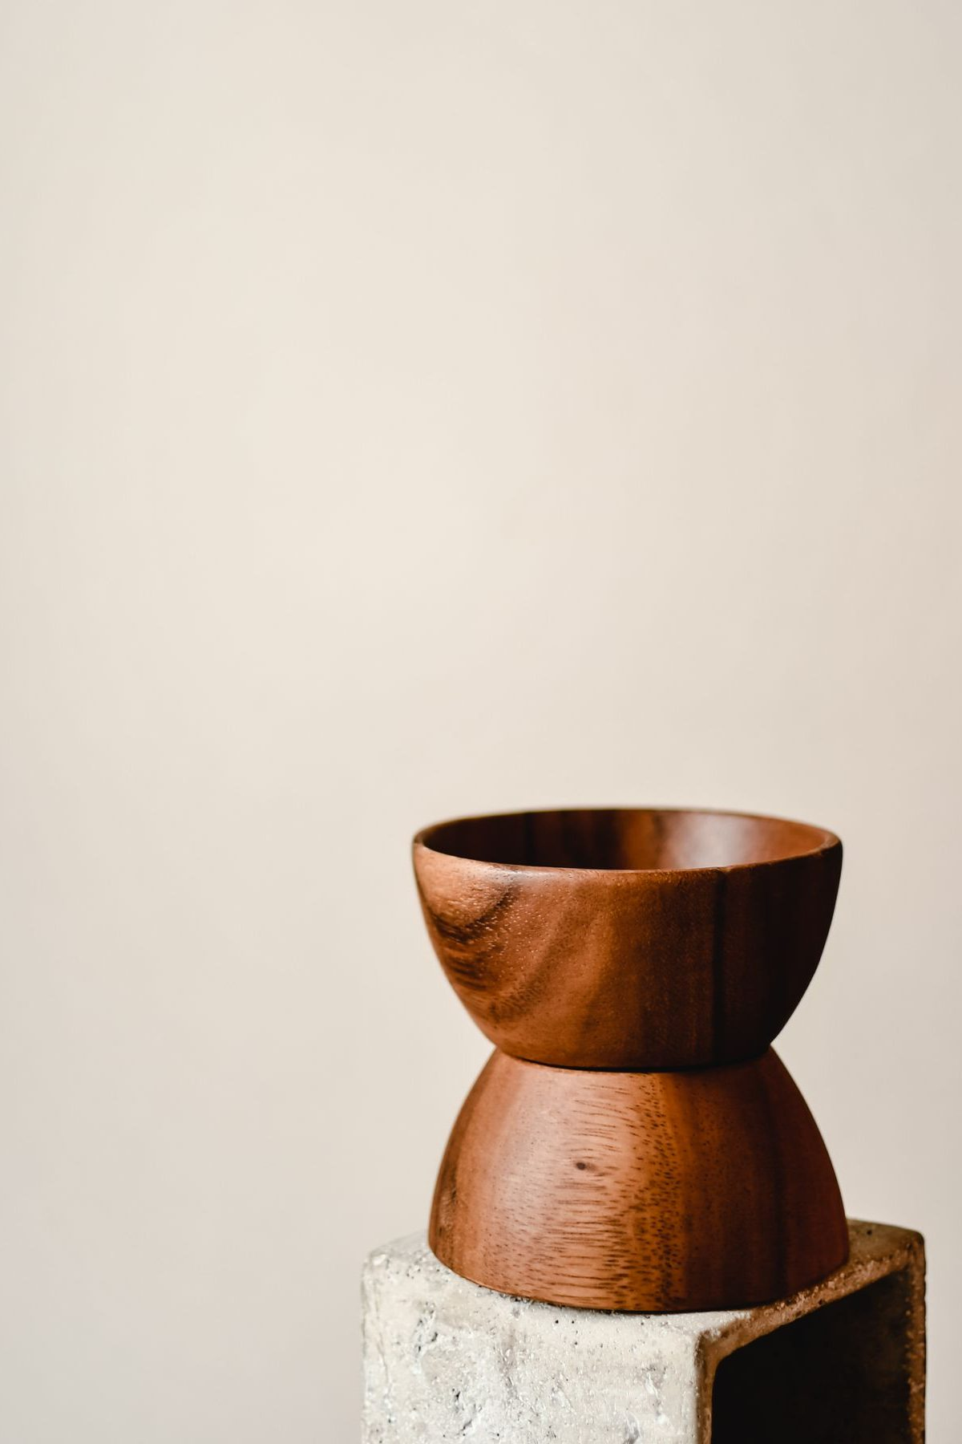
Session 12 — Tonight’s Road
1 Opening container — run slow
2 New every morning — Lam. 3:22–23, Ps. 126
3 “What held?”
4 The walk home
5 Re-anchoring the year — and the door out, once
6 Between-session practice — restart one
7 Closing container
8 Leader Feedback Round
9 Aaronic blessing and sending
153
Notes:
S12 · 7:00–7:08 · LEAD: CONTAINER HOLDER
BEATS: 1. First evenings back after Christmas — nothing new is taught today; the whole evening rebuilds what the break interrupted. 2. Three movements: 'What held?' in pairs; the Walk Home (the Path Home Card enacted); re-anchoring the year's map. 3. Deliberately adult-carried today — the container protocol itself is the teaching.
CUES: Pulse 2 bin staffed at the door — thank you and nothing else; name tags run again as if it were Week 1; note every empty chair for warm contact this week.

Slide 4
Opening Container — Run Slow
• Two weeks without Wednesdays — containers don’t keep. They are rebuilt every time, by the same small faithful steps
• “Tonight we open it slowly, on purpose. Don’t rush the steps. There is nowhere else we need to be.”
• The full eight steps — phones away, standing circle, put out / bring in, the prayer
• One-word check-in: “One word for how you actually are right now — not how you usually are, not how you should be.” Let each word have a breath
THE SPOKEN COMMITMENT
“I am here. I am paying attention. I am willing to be moved.”
154
Notes:
S12 · 7:00–7:08 · LEAD: CONTAINER HOLDER
BEATS: 1. Run ALL eight opening steps at two-thirds speed and name the slowness out loud: containers are rebuilt every time, by the same small faithful steps. 2. One-word check-in gets a second beat — one unhurried breath after each word; no commentary, no nodding anyone along. It is the most information-dense thirty seconds of the session. 3. Double the put-down silence to a full minute. 4. Spoken commitment, opening prayer, sit.
GUARD: The slow open runs about 12 minutes and IS the session's first teaching — do not rush it back to the usual clip. If the room will not settle, run it slower, not louder; contain the room, don't fight it.

Slide 5
New Every Morning — Lam. 3:22–23, Ps. 126
• Written in the ashes of Jerusalem — the mercies-new truth lives in the mornings after the seasons that didn’t hold
• Not new every morning that you earned. Issued fresh, this morning, to everyone in this circle — whatever the break looked like
• Psalm 126 — “those who sow in tears shall reap with shouts of joy!” Coming home is not make-up work; it is the happiest walk there is
• Tonight we read the break honestly — and we can afford to, because the mercy was already new before we walked in
LAMENTATIONS 3:22–23
“The steadfast love of the LORD never ceases; his mercies never come to an end; they are new every morning; great is your faithfulness.”
155
Notes:
S12 · 7:25–7:34 · LEAD: CONTENT PRESENTER
BEATS: 1. Read Lamentations 3:22–23 and Psalm 126 aloud, slowly, from the physical Bible. 2. Teach where the verse lives: in the ashes of Jerusalem — mercies-new-every-morning belongs to the mornings after the seasons that didn't hold. 3. No carried balance: His mercies are issued fresh this morning, to everyone in the circle, whatever the break looked like — that is why today's reading costs nothing. 4. Psalm 126: coming home is the happiest walk there is. Hold it — we come back to it after the pairs.

Slide 6

“What Held?”
• A reading, not a report card — which practices held through the break, and which slipped
• “Every break is a natural test, and it is a test of the practices, not of you.”
• One at a time, plain words — a parent starts in each pair
• Nobody fixes anybody. Nobody compares. Slips are data — useful information, not a verdict
• “Most of it slipped” is a complete answer; pass is a complete answer
– If time allows: “Did anything about the break surprise you?”
“When your children ask their fathers in times to come, ‘What do these stones mean?’”
— JOSHUA 4:21 (ESV)
156
Notes:
S12 · 7:34–7:57 · LEAD: CONTENT PRESENTER · PAIRS
BEATS: 1. Bridge from the front: a reading, not a report card — every break is a natural test of the practices, not of you. Then split. 2. In pairs, one at a time: which practices held, which slipped — plain words. Receive each with a nod and nothing else. 3. If time allows: 'did anything about the break surprise you?' 4. Companions keep rough counts for the debrief — numbers only, no names.
CUES: Arranged parent reads first, slips included (check the Run Card) — never cold-call a teen; 'most of it slipped' and pass are complete answers.
GUARD: Slips are data, not failure. Cut off confession warmly — 'no apology owed; that's data' — and widen the frame on any scoreboard reading. Everyone reads: a round where three talk long and four not at all has failed its shape.

Slide 7
The Walk Home
• The Path Home Card — filed weeks ago, while the room was warm. Tonight it is not taught; it is enacted
• “Nobody in this room owes anybody an explanation for the break. You already walked back. You are in the chair. That is the whole return.”
• The way back is unglamorous: do not start over from the beginning; begin again on the next available day. Five dry minutes tomorrow morning is a full return
• Everybody here came back — every chair filled tonight is a small feast
• If the break was hard in ways that have nothing to do with practices — that is a Companion conversation, tonight or this week
LUKE 15:20
“But while he was still a long way off, his father saw him and felt compassion, and ran and embraced him and kissed him.”
157
Notes:
S12 · 7:57–8:15 · LEAD: CONTENT PRESENTER
BEATS: 1. The heart of the session. Speak the welcome over the WHOLE room at once, so everyone who drifted walks back through the door together and nobody has to identify themselves to be received. 2. Luke 15: 'while he was still a long way off' — the father runs; nobody owes an explanation before the robe. 3. The house rule, said aloud: nobody in this room owes anybody an explanation for the break. You are in the chair — that is the whole return. 4. The way back is unglamorous: begin again on the next available day; five dry minutes tomorrow is a full return. Every chair filled today is a small feast.
CUES: No hands, no testimonies, no self-identification. If someone names their own drift, bless the telling, honor the return, add nothing. Watch for the going-still and the wet eyes — no spotlight; follow up at the door or this week.

Slide 8
Re-Anchoring the Year
• Behind us: the whole God arc — the container, your story, the soils, being known; then the hearing: PROAPT, the garden, the doubts brought honestly
• “That work is in you now. The break did not take it away.”
• Ahead: Week 13 — Mission, the turn outward; then the Rhythm — one card you build with your own hand; then the sendings and the commissionings
• “We are not starting over tonight. We are picking the trail back up, together, further along than we have ever been.”
158
Notes:
S12 · 8:15–8:20 · LEAD: CONTENT PRESENTER
BEATS: 1. Brief and plain — the map moment. 2. Behind us: the whole God arc — container, story, soils, being known, then PROAPT, the garden, the doubts brought honestly. That work is in you now; the break did not take it away. 3. Ahead: Week 13 turns outward to Mission; then the Rhythm week; then the closing quarter and the commissionings. 4. 'We are not starting over today. We are picking the trail back up, together, further along than we have ever been.'

Slide 9
One More Thing, While We Are Getting Our Bearings
• Pastor Bobby Gore · (831) 277-9878 — still there, and still not part of our team
• His number is on the safety page at the front of your journal
• Same as we said in September
159

Slide 10

Homework — Two Weeks, Four Parts — Restart One
• Not everything. One daily practice — the morning question, the evening note, or PROAPT. Just one
• Write it at the top of a fresh journal page tonight, with when and where: “The morning question, 6:50, kitchen table”
• That one practice, daily, this week
• Miss a day? Do not start over — begin again on the next available day
• “One seed goes back in the ground. His mercies are new every morning; you only need one practice to be standing there when they arrive.”
160
Notes:
S12 · 8:20–8:24 · LEAD: CONTENT PRESENTER
BEATS: 1. Co-Companion (Parent) leads. Restart ONE daily practice — just one; the smallness is the wisdom. 2. Journals open, ninety seconds to write: the practice at the top of a fresh page with when and where — 'the morning question, 6:50, kitchen table.' 3. Miss a day? Do not start over from the beginning — begin again on the next available day. One seed goes back in the ground this week.

Slide 11
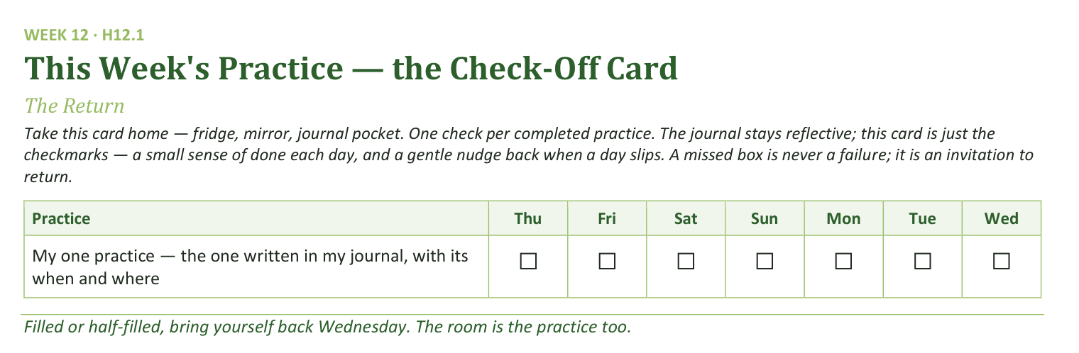
Your Take-Home Card — This Session’s Practice
Handed out now — fridge, mirror, journal pocket.
161
Notes:
S12 · 8:20–8:24 · LEAD: CONTENT PRESENTER
BEATS: 1. One row only this week: my one practice, with its when and where. 2. A missed box is never a failure — it is an invitation to return. 3. The rest of the rhythm comes back a piece at a time in the coming weeks.

Slide 12
Closing the Container + Aaronic Blessing
• We close the way we opened — the container, six steps:
1 Stand again — same circle, same posture as the open
2 One-word landing — compare it to your opening word
3 The one thing you are taking from tonight
4 The one practice — committed aloud, or modified to one you will actually keep
5 Blessings — specific, witnessed, short
6 Closing prayer — and the Aaronic blessing, spoken over each other, face to face
THE AARONIC BLESSING — NUMBERS 6:24–26
“The Lord bless you and keep you;
the Lord make his face to shine upon you, and be gracious to you;
the Lord lift up his countenance upon you, and give you peace.”
162
Notes:
S12 · 8:28–8:30 · LEAD: CONTAINER HOLDER
BEATS: 1. Closing protocol 5:12–5:20, unhurried: stand; one-word landing (the contrast with the opening words is today's best data); the one thing taken from today; the one practice (each names the one just written); blessings — let this step run warm today; the first evenings back is the right night for the room to bless itself. 2. Then the Leader Feedback Round interposes, 5:23–5:27 (next slide). 3. Return here 5:27–5:30: 'His mercies did not run out over the break, and they will not run out over this quarter.' Aaronic blessing, hands up. 'Welcome home. See you evenings — Week 13, Mission.'
CUES: Today's order is unusual — closing container BEFORE the feedback round, blessing last. Follow the slide flow, not habit.

Slide 13
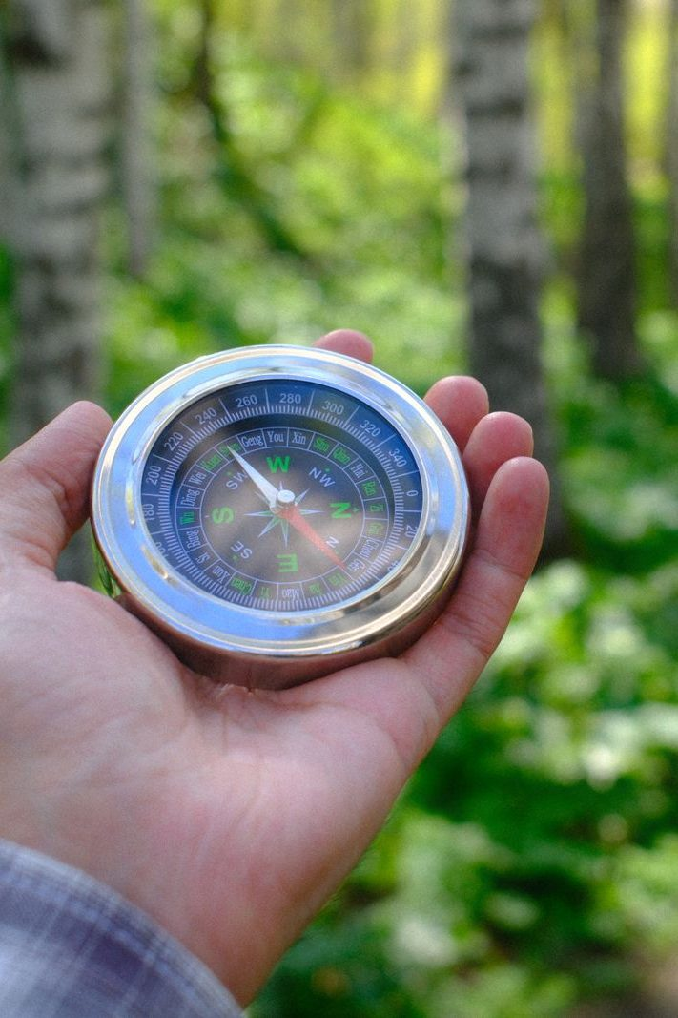
The Leader Feedback Round
• Two rounds, same as every session — the container holder first, then the content presenter: three things each
– “What I think went well tonight: ______”
– “What I’d do differently next time: ______”
– “If I were to teach tonight’s process to someone, I would tell them: ______”
• Then the room — the same two questions about tonight
• The leaders receive without defending — “thank you” is the whole response
163
Notes:
S12 · 8:24–8:28 · LEAD: BOTH LEADERS
BEATS: 1. Same round: leader's three answers first, then the room's two questions; 'thank you' is the whole response. 2. Today it sits between the closing container and the blessing — after this round, flip back for the Aaronic blessing and sending. 3. May be dropped if the room's energy needs something else; dropping it twice running goes to the team debrief.

